Slide 1
CSS342 Data Structures, Algorithms, and Discrete Mathematics (I)

Slide 2
Goals by the end of this week (10/15, 10/17)
Have a solid understanding about Abstract Data Type
Write your own linked list
With tests
Get comfortable with CMake & Googletest
Textbook “Data Abstraction & Problem Solving With C++”
Study group

Slide 3
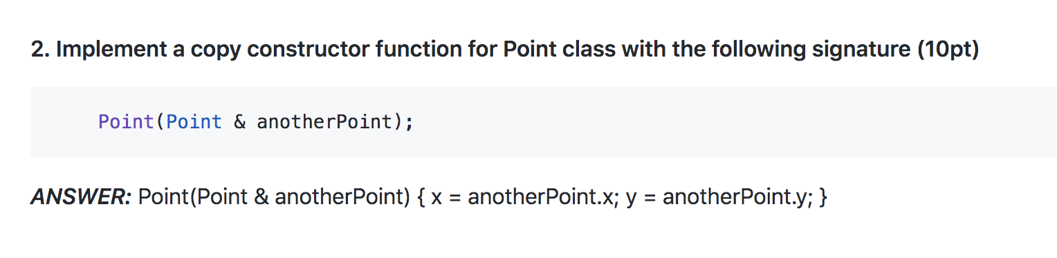
Notes on homework 1
Copy constructor
From quiz 1

Slide 4
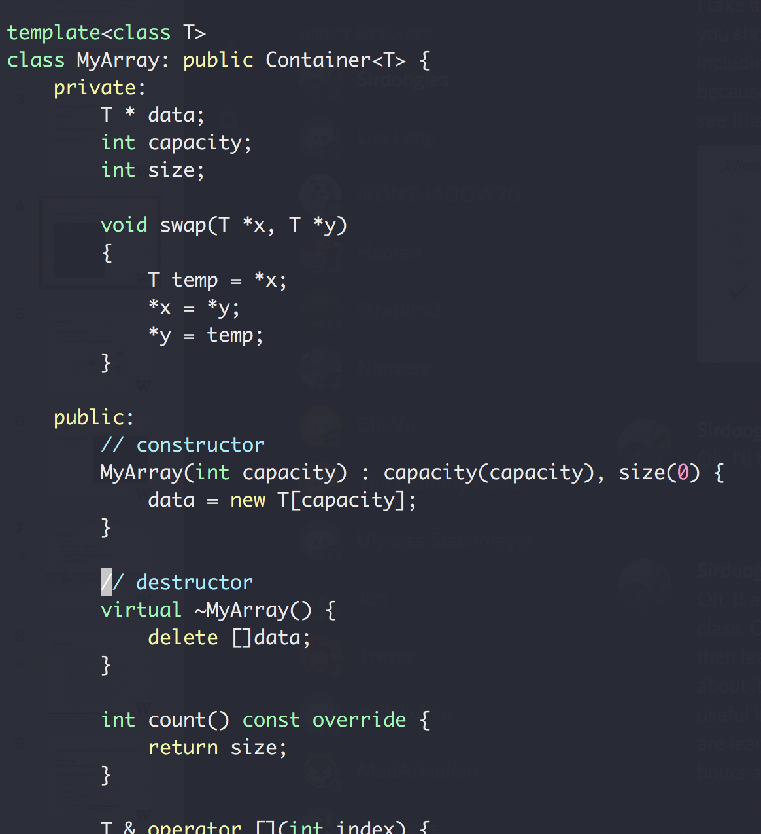
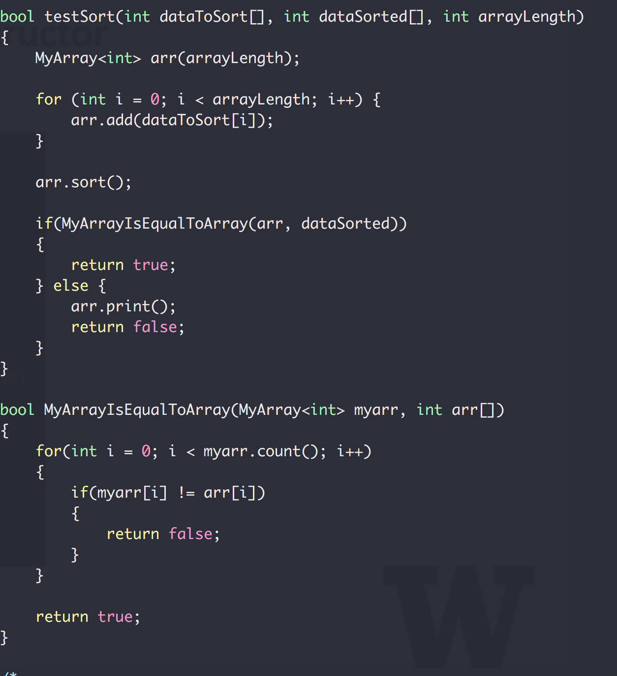
More on Copy Constructor
What’s being passed in?

Slide 5

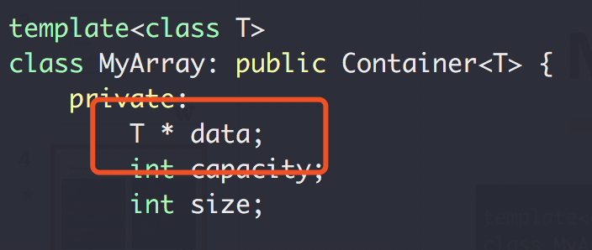
More on Copy Constructor
The copy constructor:
creates an object
initializing it with another object of the same class
Okay, but what if a copy constructor is not defined in a class?
the compiler itself defines one implicitly
Okay, but what if the class has pointer variables and has some dynamic memory allocations?
Array1.data
Data[]
Array1.data
Shallow copy!!

Slide 6
Shallow copy vs Deep copy
Shallow copy: copy the pointer variable only
Deep copy: copy what’s being pointed
See https://www.cs.utexas.edu/~scottm/cs307/handouts/deepCopying.htm
This will be in quiz/exam

Slide 7
C++ Standard Template Library
A powerful set of C++ template classes

Slide 8
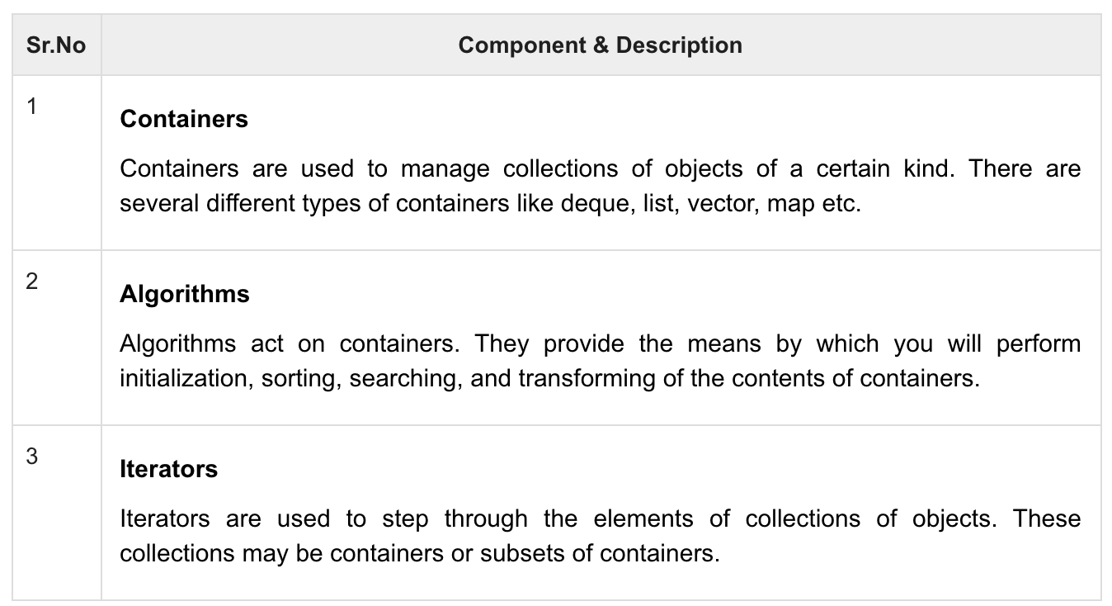
C++ Standard Template Library
A powerful set of C++ template classes
Provide general-purpose classes and functions with templates that implement many popular algorithms and data structures like vectors, lists, queues, and stacks.
https://www.tutorialspoint.com/cplusplus/cpp_stl_tutorial.htm

Slide 9
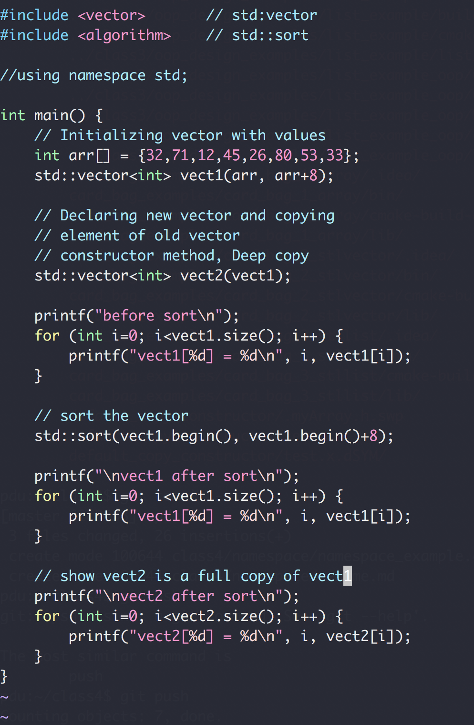
C++ Standard Template Library

Slide 10
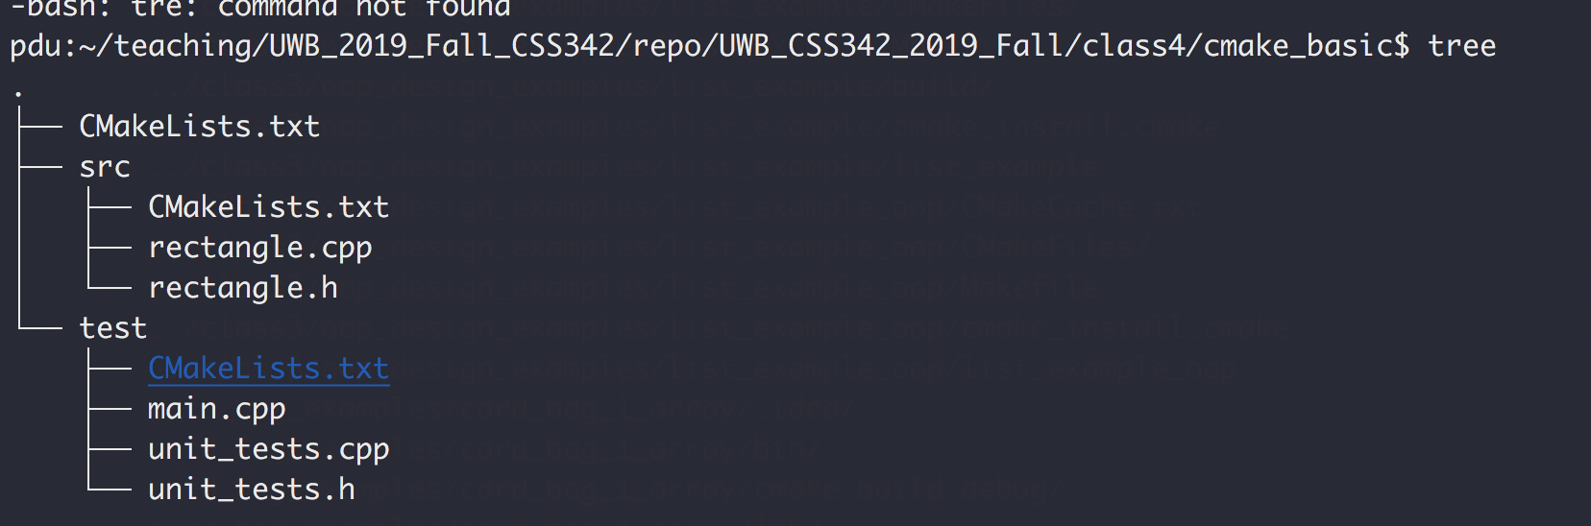
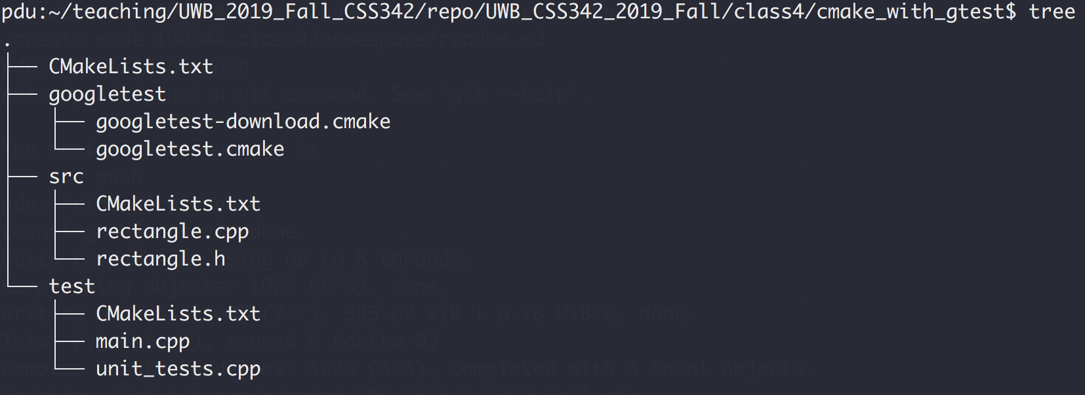
CMake & Googletest
cmake_basic
cmake_with_gtest

Slide 11
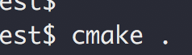
CMake
Create Makefile for you
To run, type:
this will generate all the Makefiles
And then to compile, run ”make” as before

Slide 12
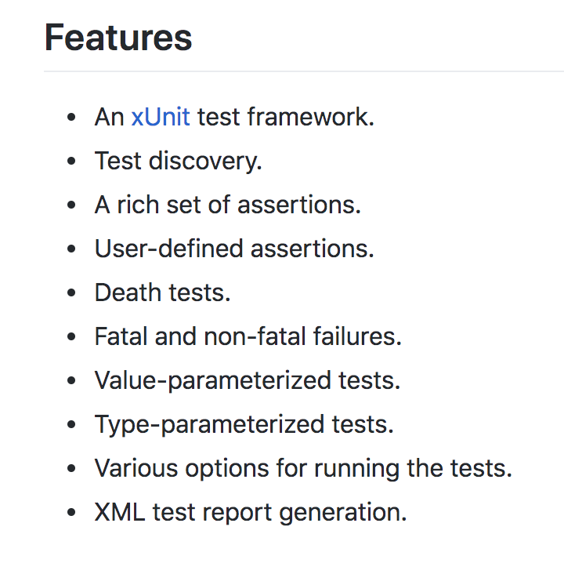
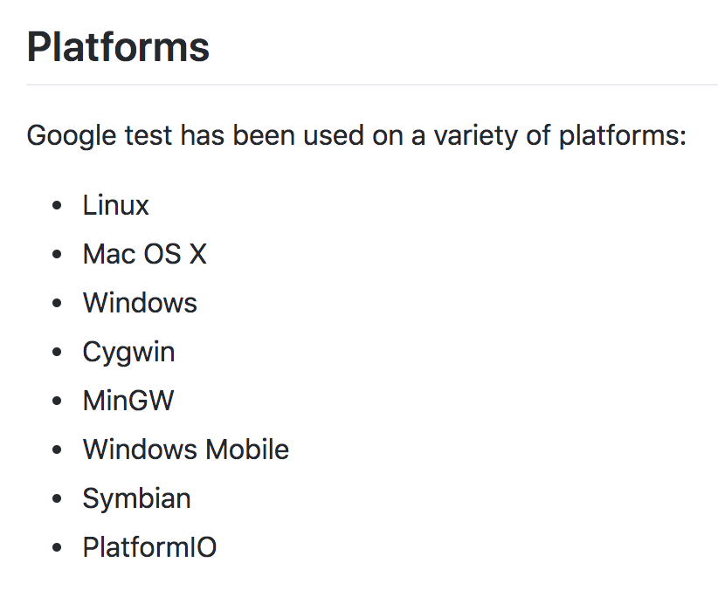
Googletest
https://github.com/google/googletest

Slide 13
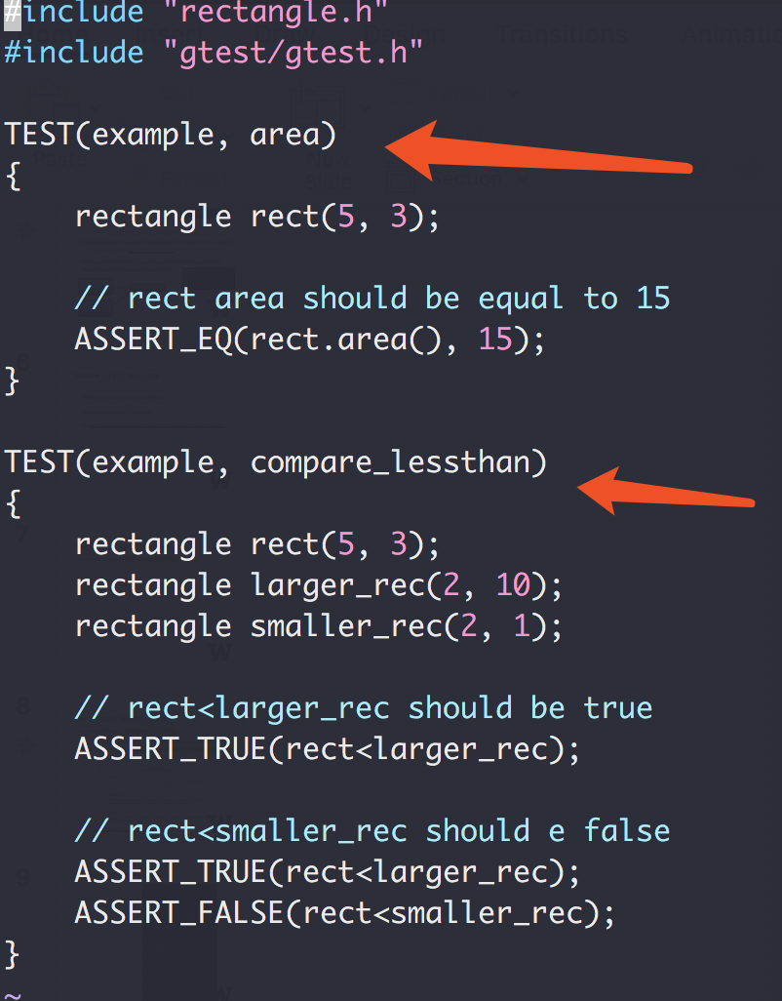
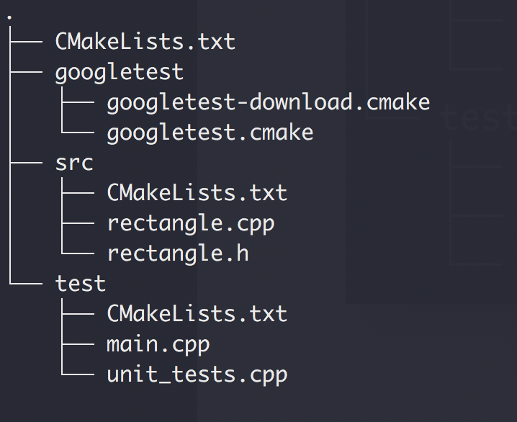
Googletest as our Testing Infrastructure
Our Code Structure

Slide 14
Exercise 1
Design a Stack ADT
First in, last out
Usage: reverse a list, and many others

Slide 15
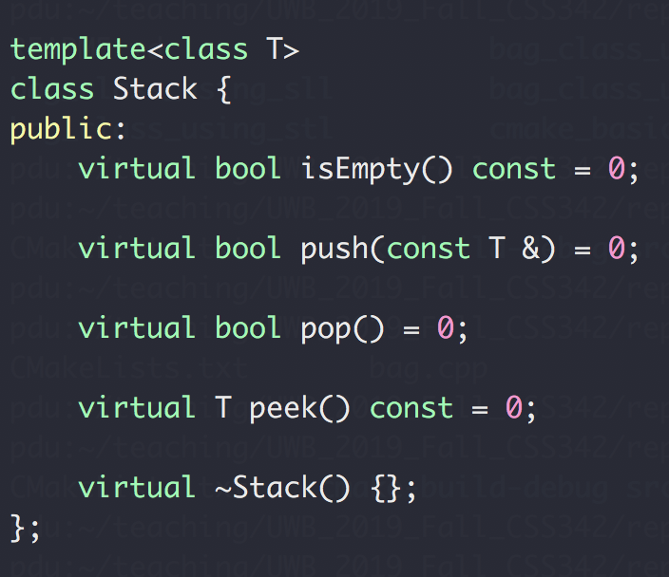
Exercise 1
Design a Stack ADT
First in, last out

Slide 16
Exercise 2
Design a Single Linked List
A collection of nodes
Can only be accesses in a sequential way
No random access
Node
NEXT
NEXT
NEXT
NEXT
end

Slide 17
Exercise 2
Design a Single Linked List
A collection of nodes
Can only be accesses in a sequential way
No random access
prepend(value) : Add a node in the beginning append(value) : Add a node in the end
pop() : Remove a node from the end popFirst() : Remove a node from the beginning
head() : Return the first node tail() : Return the last node
remove(Node) : Remove Node from the list
iterator: iterate through the list
https://medium.com/@lucasmagnum/sidenotes-linked-list-abstract-data-type-and-data-structure-fd2f8276ab53

Slide 18
Abstract Data Type Design
ADT
Interface Design
Implementation
Details

Slide 19
The (modified) ADT Bag (C++ ch 1)
A bag of card of different shape cards

Slide 20
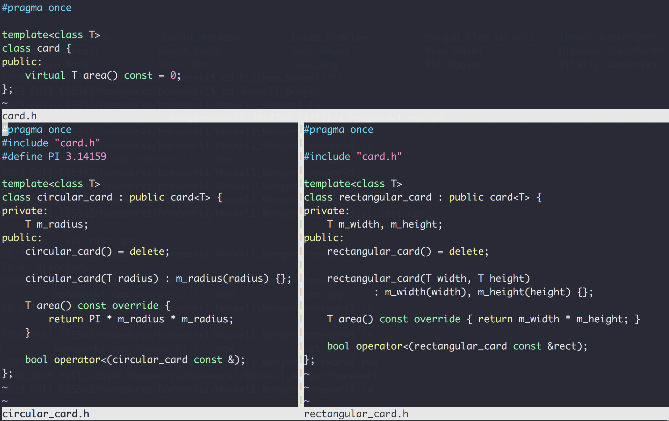
ADT Bag : cards
class card, circular_card, rectangular_card
Base Class
Derived Class
Derived Class

Slide 21
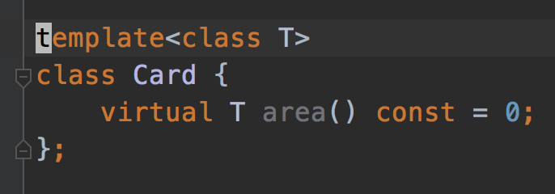
A bag of cards
Design a bag ADT that contains a collection of cards
Cards can be a circular card, rectangular card or any kind that derived from the Card interface
All cards in the same bag will have the same type T

Slide 22
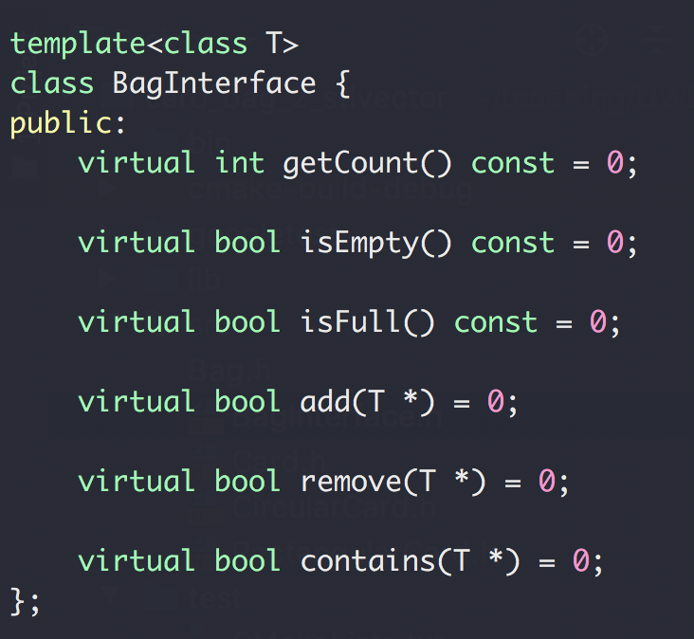
A bag of cards
Interface Design

Slide 23
A bag of cards
Implementation Design
how would you design this based on these card classes

Slide 24
A bag of cards
Data:
A collection of cards
Capacity
Size
Array-based
List-based
Contiguously addressed in memory
Fast random access
Hard to adjust size
Random address in memory
Slow random access
Easy to adjust size

Slide 25
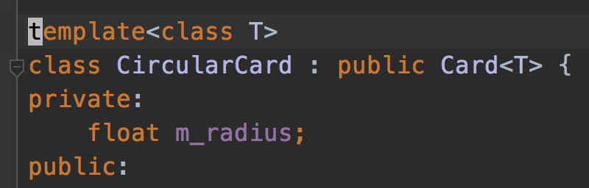
A bag of cards

Slide 26
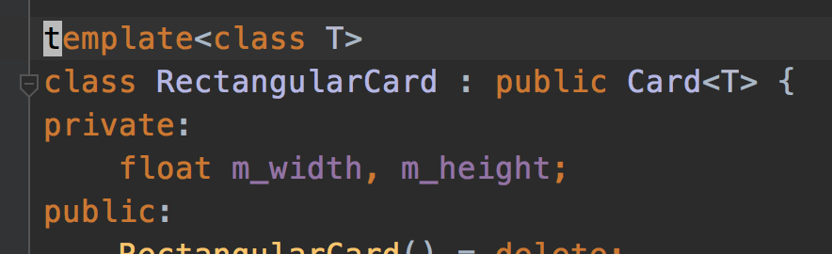
A bag of cards

Slide 27
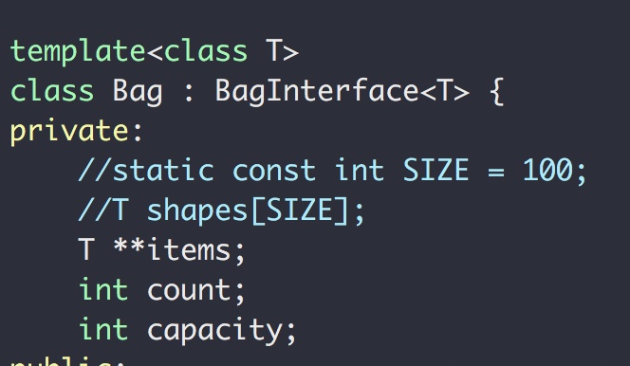
A bag of cards
If you don’t know what “std::” means , see this

Slide 28
A bag of cards
p1
← Object in memory
p2
Card<T>* p1
Card<T> ** items
p3
Card<T>* p1
Card<T>* p2
Card<T>* p3
Card<T>* p4
p4

Slide 29
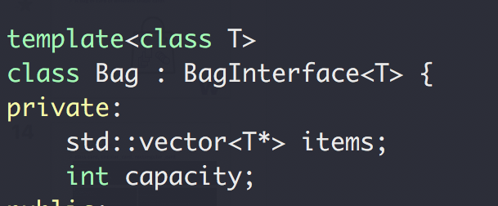
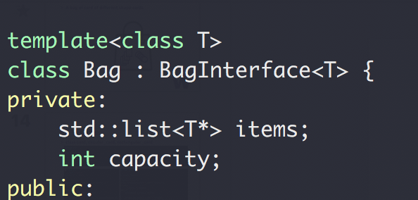
A bag of cards
Array
STL vector
STL list
If you don’t know what “std::” means , see this

Slide 30
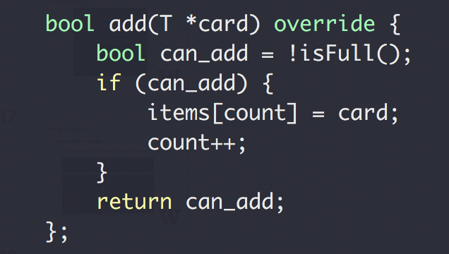
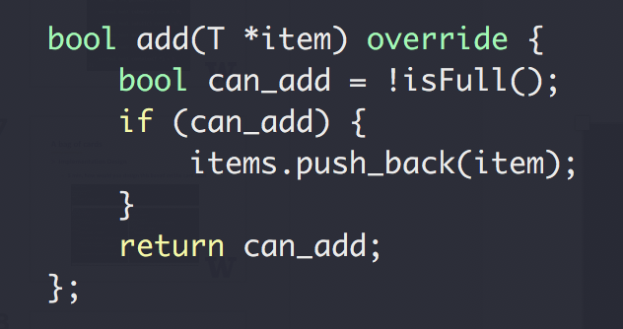
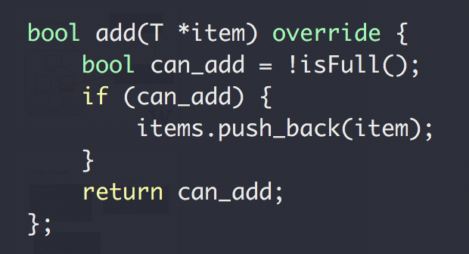
A bag of cards: add()
Using array
Using STL vector
Using STL list
Same applies to
remove(T *item)
contains(T *item)

Slide 31
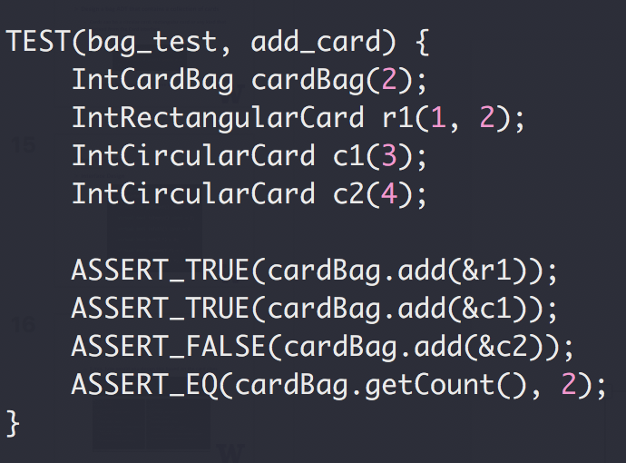
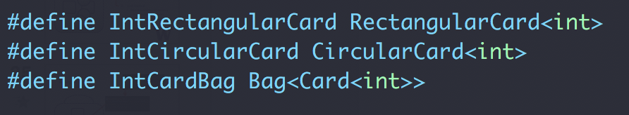
A bag of cards
From testing (user) perspective:
What did we change in test for each storage type (array, vector, list?)
Nothing! All test codes are exactly the same!

Slide 32
Abstract Data Type Design
The (modified) ADT Bag (C++ ch 1)
Interface
Implementation (storage option)
Storage option
Array based (C++ ch3)
C++ array (primitive array) , or
C++ Standard Template Library array(vector)
List Based (C++ ch4)
C++ Standard Template Library array(list), or
Our own singly linked list (SLL)
And once we have our own SLL
Stack
Queue
… next week

Slide 33
A bag of cards
Summary
Same interface
Different implementation
Same test code
Next up
Replace std::list with our own singly linked list

Slide 34
Notes
Study Groups (Saturday 2-4pm)
Midterm
Materials covered up to next Tuesday (10/22)
Exam review next Thursday
Focus on class materials and examples

Slide 35
Design a Single Linked List
A collection of nodes
Can only be accesses in a sequential way
No random access
Node
Next
Next
Next
Next
end

Slide 36
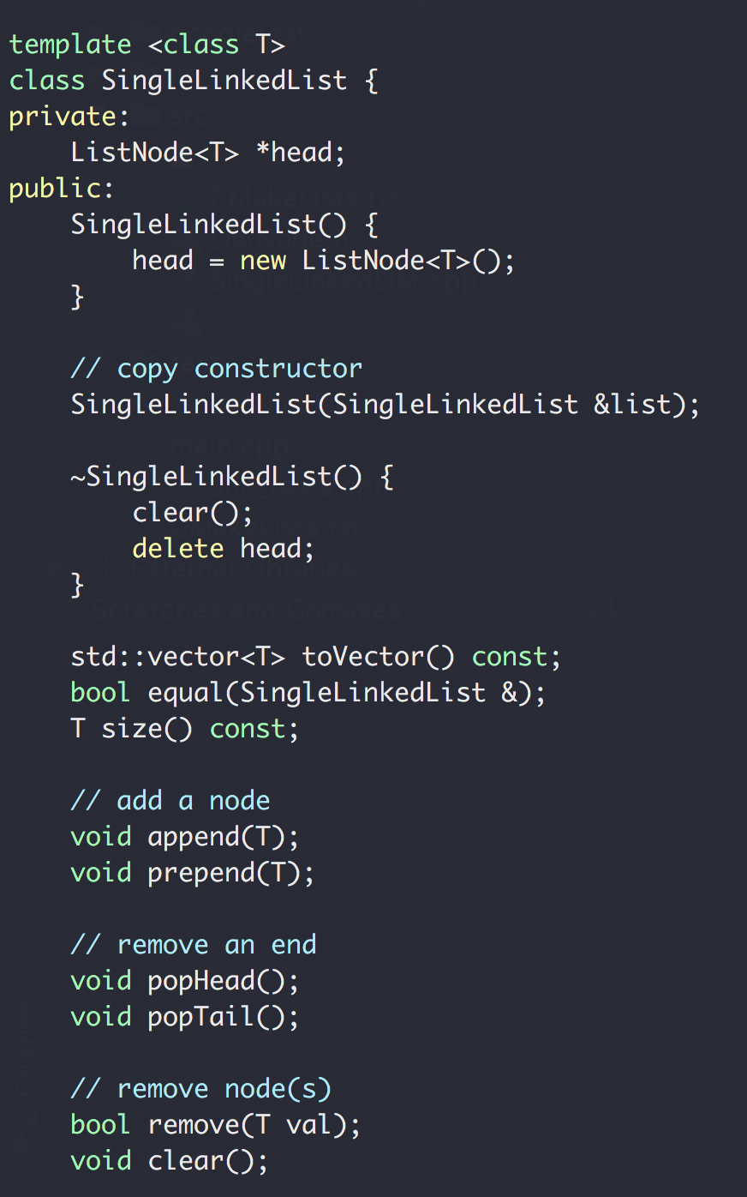
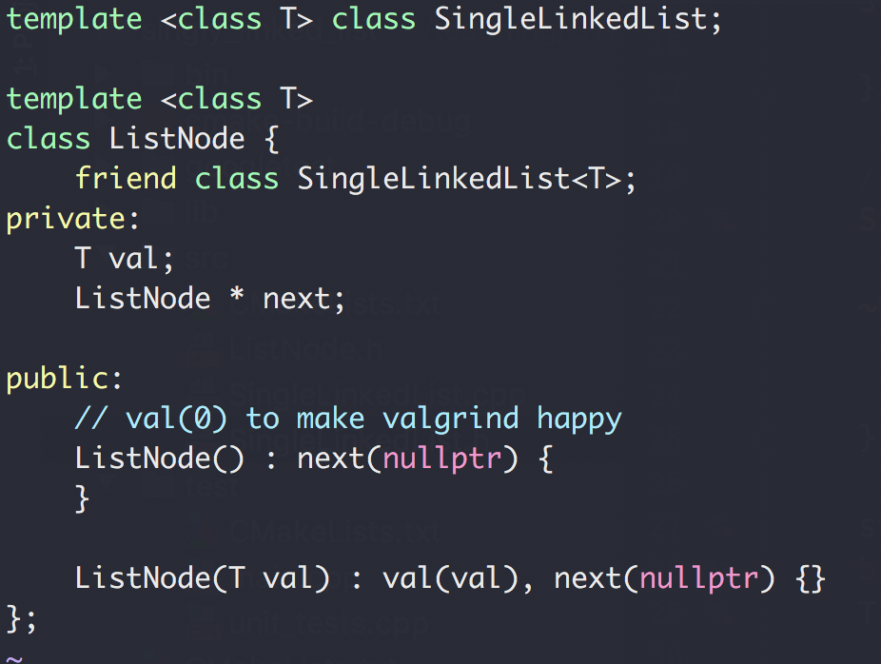
Single Linked List
Single Linked List (SLL)
Next
Next
Next
Next
end
Node
Next

Slide 37
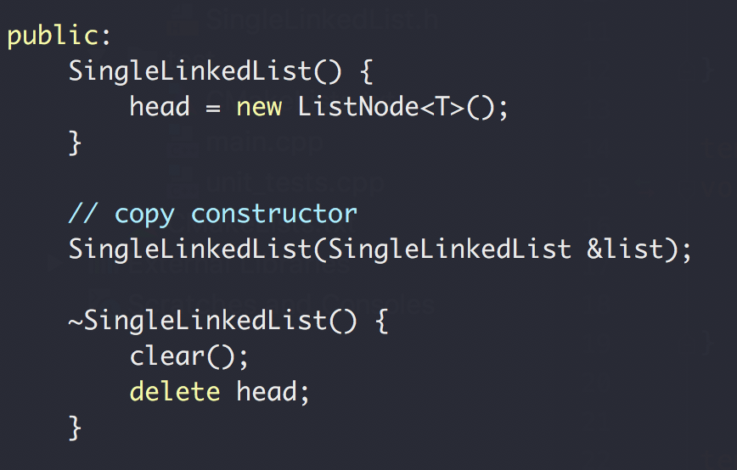
Single Linked List
Create a new (empty) list
Constructor
Delete a list
Destructor
Always keep an empty head node
More on ”dummy/header” node

Slide 38
Single Linked List
Single Linked List (SLL)
Next
Next
Next
Next
end

Slide 39
SingleLinkedList<T>::append(T val)
Add a node with value to the END(TAIL) of the list
head
val = 1
Next
Next
end/nullptr
Add a node with val = 2 to the end
head
val = 1
val = 2
Next
Next
Next
nullptr

Slide 40
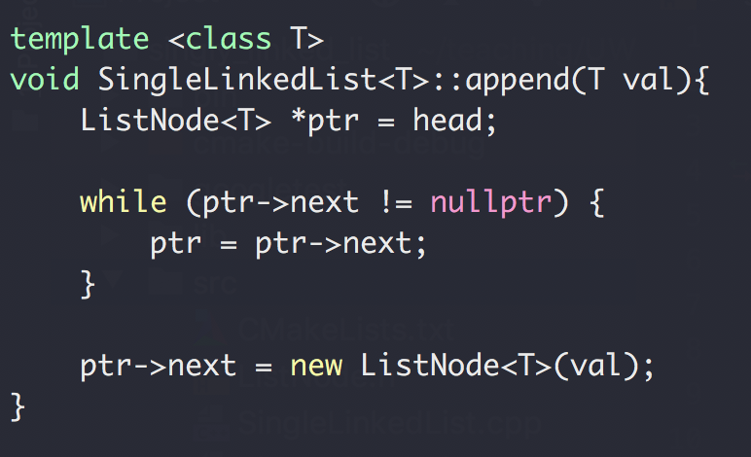
SingleLinkedList<T>::append(T val)
Add a node with value to the END of the list
val = 1
val = 2
val = 3
Next
Next
Next
end

Slide 41
SingleLinkedList<T>::append(T val)
head
val = 1
Next
Next
nullptr
ptr
ptr

Slide 42
SingleLinkedList<T>::append(T val)
head
val = 1
val = 2
Next
Next
Next
nullptr
ptr

Slide 43
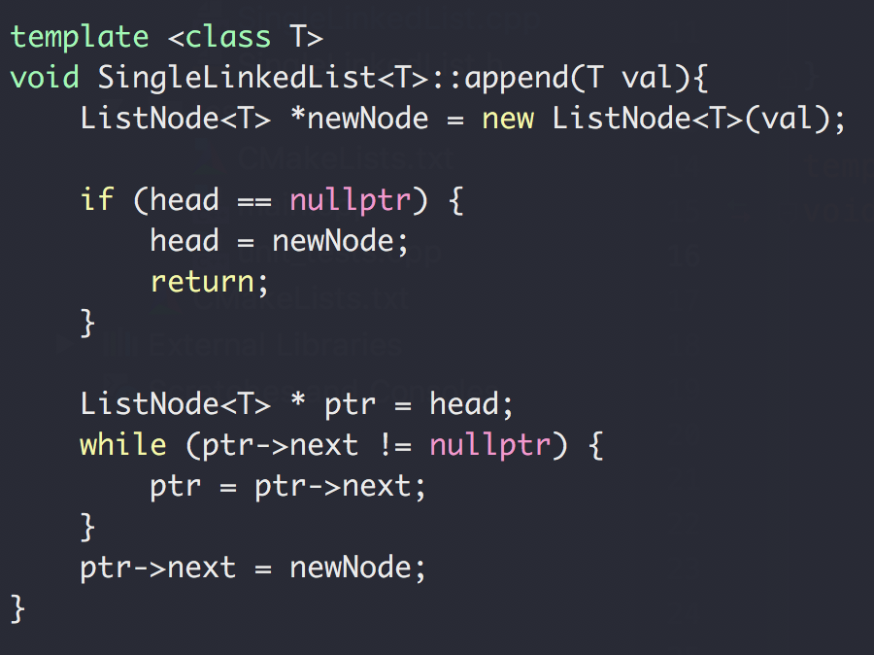
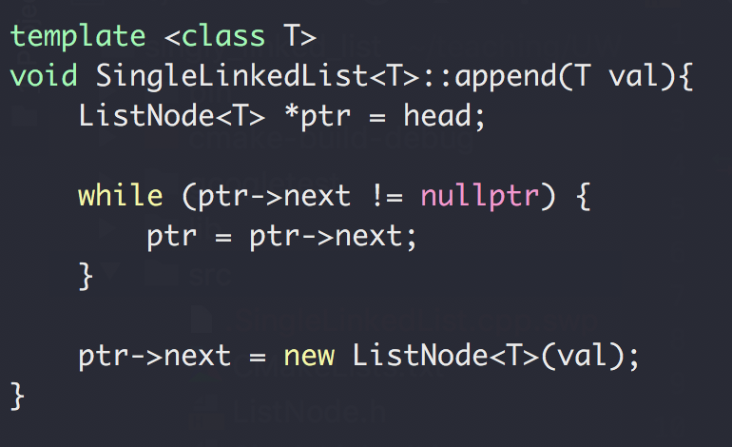


SingleLinkedList<T>::append(T val)
With or without the empty head node

Slide 44
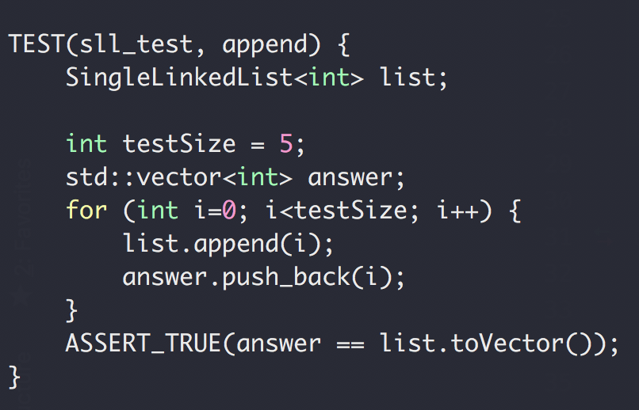
SingleLinkedList<T>::append(T val)
Add a node with value to the END of the list
val = 1
val = 2
val = 3
Next
Next
Next
end

Slide 45
SingleLinkedList<T>::prepend(T val)
Add a node with value to the FRONT(HEAD) of the list
head
val = 1
Next
Next
end
Add a node with val = 2 to the front
head
val = 2
val = 1
Next
Next
Next
end

Slide 46
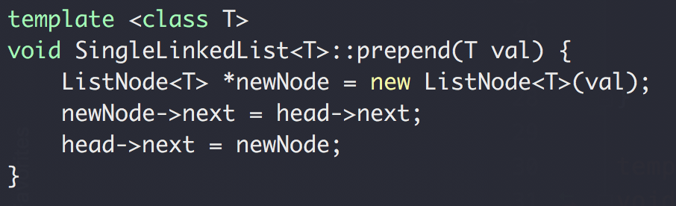
SingleLinkedList<T>::prepend(T val)
Add a node with value to the FRONT of the list
head
val = 2
val = 1
Next
Next
Next
end

Slide 47
SingleLinkedList<T>::prepend(T val)
head
val = 1
Next
Next
nullptr

Slide 48
SingleLinkedList<T>::prepend(T val)
val = 2
Next
head
val = 1
Next
Next
nullptr

Slide 49
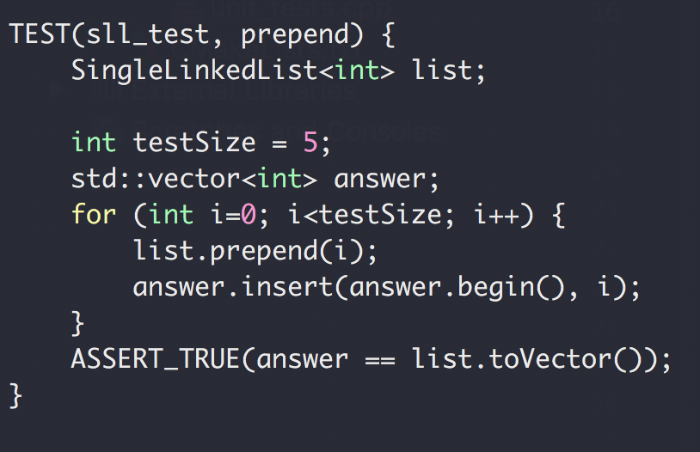
SingleLinkedList<T>::prepend(T val)
Add a node with value to the FRONT of the list
head
val = 2
val = 1
Next
Next
Next
end

Slide 50

SingleLinkedList<T>::popHead()
Remove the Head (first node) of the list
head
val = 1
val = 2
Next
Next
Next
nullptr
head
val = 2
Next
Next
nullptr

Slide 51
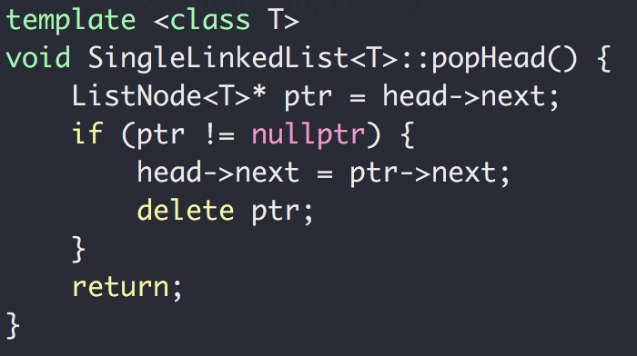
SingleLinkedList<T>::popHead()
Remove a node at the FRONT of the list
head
val = 1
val = 2
Next
Nest
Nest
nullptr

Slide 52
SingleLinkedList<T>::popHead()
head
val = 1
val = 2
Next
Nest
Nest
nullptr
ptr

Slide 53
SingleLinkedList<T>::popHead()
head
val = 1
val = 2
Next
Nest
Nest
nullptr
ptr

Slide 54
SingleLinkedList<T>::popHead()
head
val = 1
val = 2
Next
Nest
Nest
nullptr
ptr

Slide 55
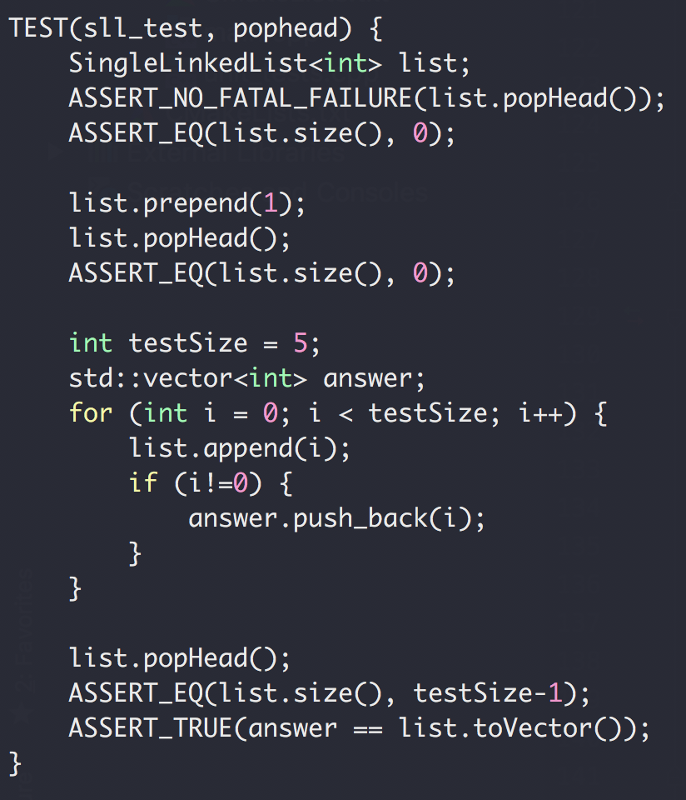
SingleLinkedList<T>::popHead()
Remove a node at the FRONT of the list
head
val = 1
val = 2
Next
Nest
Nest
nullptr

Slide 56
SingleLinkedList<T>::popTail()
Remove a node at the END of the list
head
Next
nullptr
head
val = 1
Next
Nest
nullptr
head
val = 1
val = 2
Next
Next
Next
nullptr

Slide 57
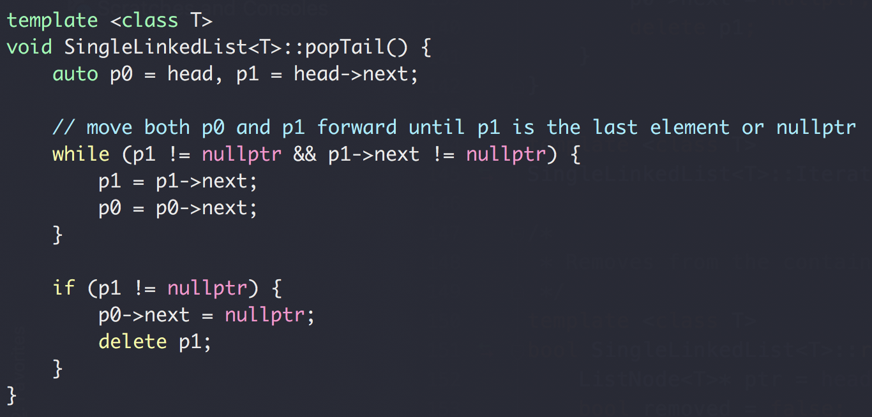
SingleLinkedList<T>::popTail()
Remove a node at the END of the list
head
Next
nullptr
p0
p1

Slide 58
SingleLinkedList<T>::popTail()
Remove a node at the END of the list
head
val = 1
Next
Nest
nullptr
p0
p1

Slide 59
SingleLinkedList<T>::popTail()
Remove a node at the END of the list
head
val = 1
Next
Nest
nullptr
p0
p1

Slide 60
SingleLinkedList<T>::popTail()
Remove a node at the END of the list
head
val = 1
val = 2
Next
Nest
Nest
nullptr
p0
p1
p0
p1

Slide 61
SingleLinkedList<T>::popTail()
Remove a node at the END of the list
head
val = 1
val = 2
Next
Nest
Nest
nullptr
p0
p1

Slide 62
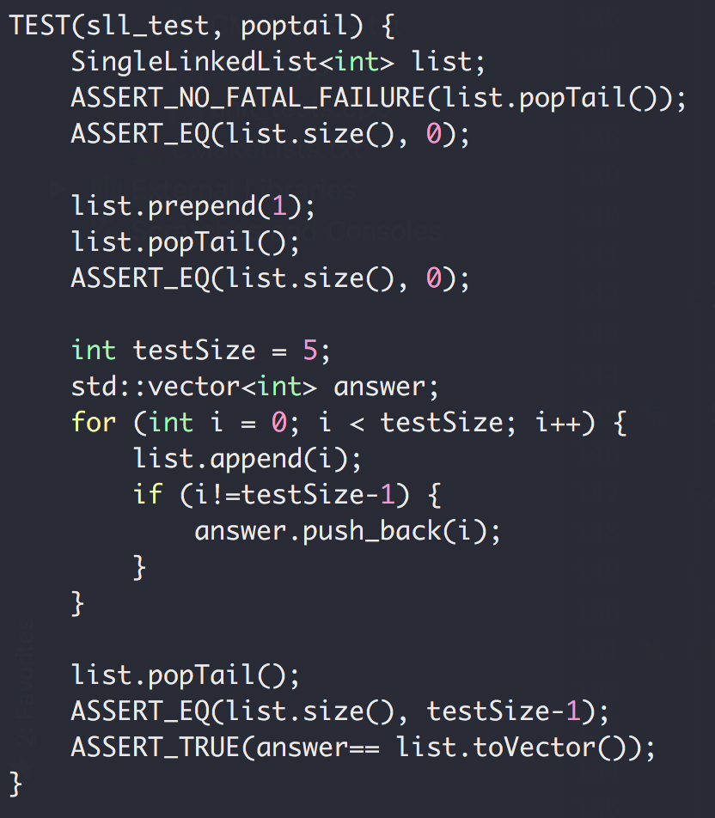
SingleLinkedList<T>::popTail()
Remove a node at the END of the list
head
Next
nullptr
head
val = 1
nullptr
Next
Nest
head
val = 1
val = 2
Next
Nest
Nest
nullptr

Slide 63
Exercise
Reverse a linked list
Input:
h → 1 → 2 → 3→ 4→ 5 → N
Output:
h → 5 → 4 → 3→ 2→ 1 → N

Slide 64
Exercise
h → 2 → 3→ 4→ 5 → N
p0
p1
p2
h → 3 → 2→ 4→ 5 → N
Reverse a linked list
p0
p1
p2
h → 4 → 3→ 2→ 5 → N
p0
p1
p2
h → 5 → 4→ 3→ 2→ N
p0
p1
p2

Slide 65
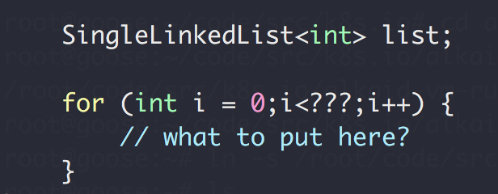
How to loop through a linked list?
Next
Next
Next
Next
end
Do not expose the *next pointer
Internal details
safety

Slide 66
Iterator
ADT for pointer to nodes in a linked list
head
val = 1
val = 2
Next
Nest
Nest
nullptr
ptr
STL containers have iterator too!

Slide 67
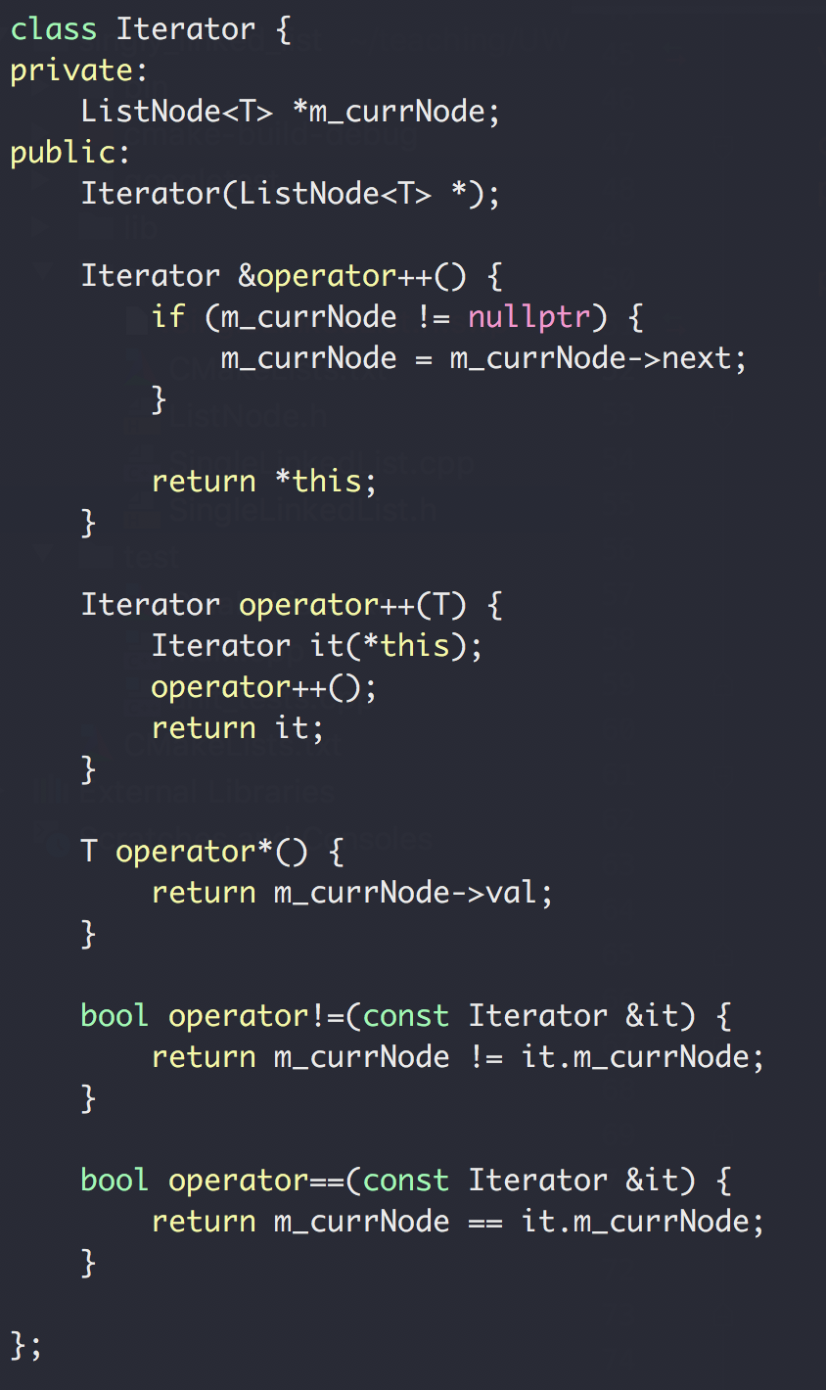
Iterator
ADT for pointer to nodes in a linked list
head
val = 1
val = 2
nullptr
Next
Nest
Nest
ptr

Slide 68
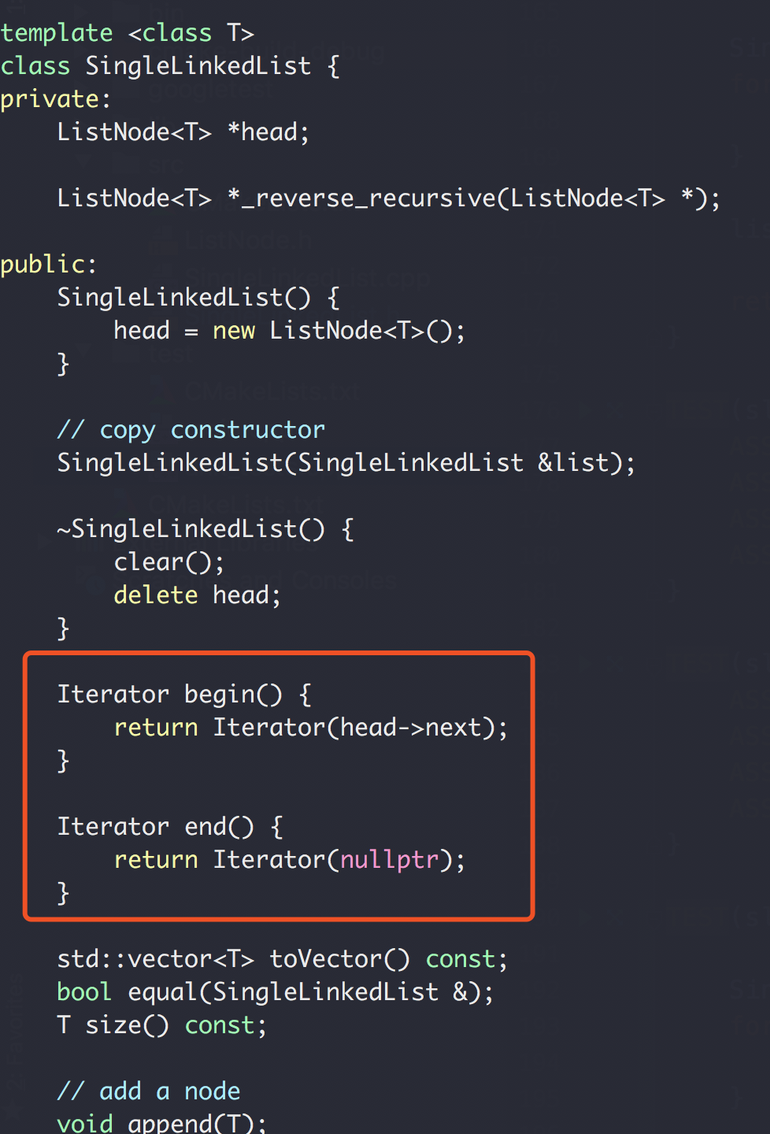
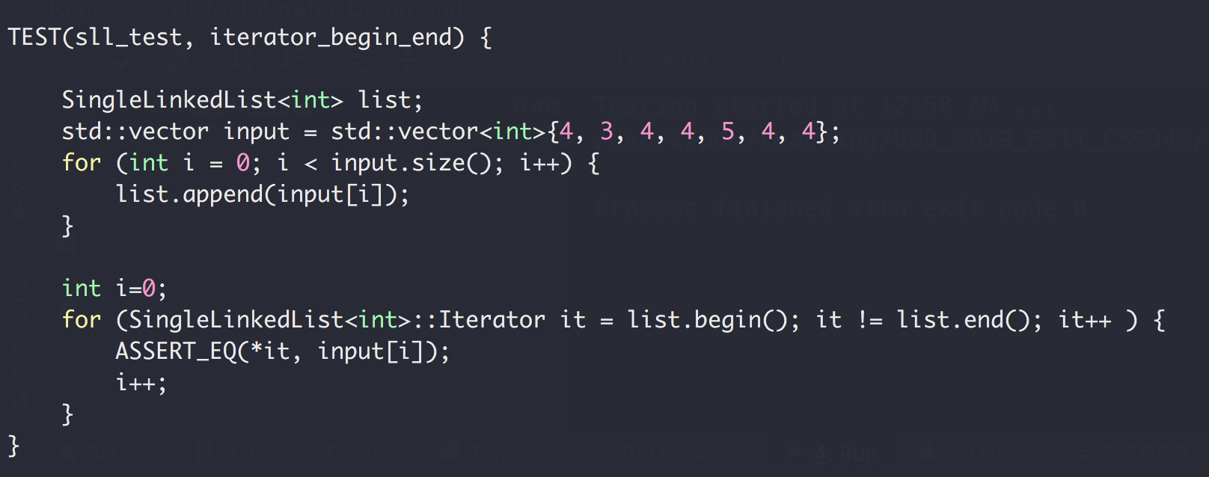
Iterator
ADT for pointer to nodes in a linked list
head
val = 1
val = 2
nullptr
Next
Nest
Nest
ptr

Slide 69
Iterator
head
val = 1
val = 2
Next
Next
Next
nullptr
Iterator {
private:
ListNode *p;
}
ptr
From inside SingleLinkedList<T>
From outside SingleLinkedList<T>

Slide 70
More on Linked List
Singly Linked List
Doubly Linked List
head
nullptr
Prev
Next
Prev
Nest
Prev
Nest

Slide 71
Node Implementation
Node
Full Object
Pointer
Next
Next
Next
Next
Next
Next
nullptr
*ptr
*ptr
*ptr
nullptr
Next
Next
Next
Next
Next
Next

Slide 72
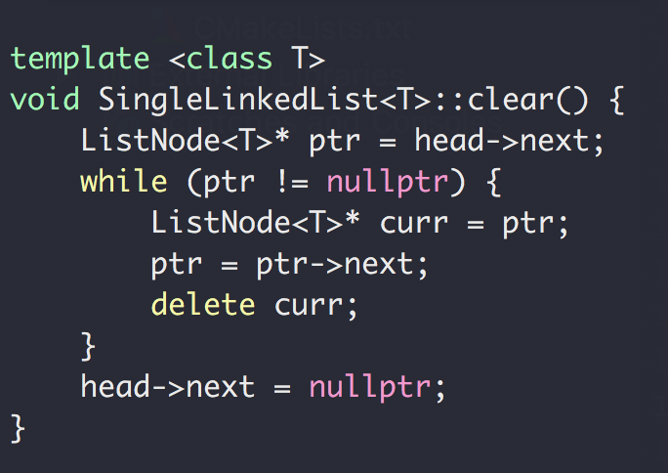
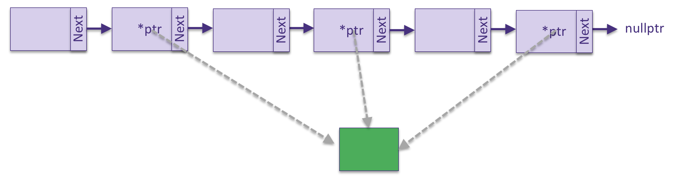
List Destruction
What if T is a pointer to another object?

Slide 73
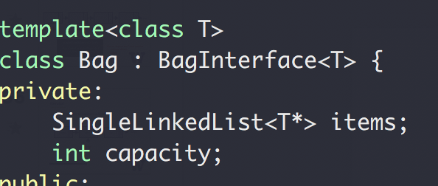
Use our SingeLinkedList ADT

Slide 74
Summary
ADT Bag of items
Abstract Data Type
Interface
Implementation
ADT List
ADT Node
ADT Iterator

Slide 75
Summary
ADT Bag of items
ADT List
ADT Node
ADT Iterator
Stack/Queue/…

Slide 76
Stack
Design a Stack ADT
First in, last out
Usage: reverse a list, and many others

Slide 77
Stack
Design a Stack ADT
First in, last out

Slide 78
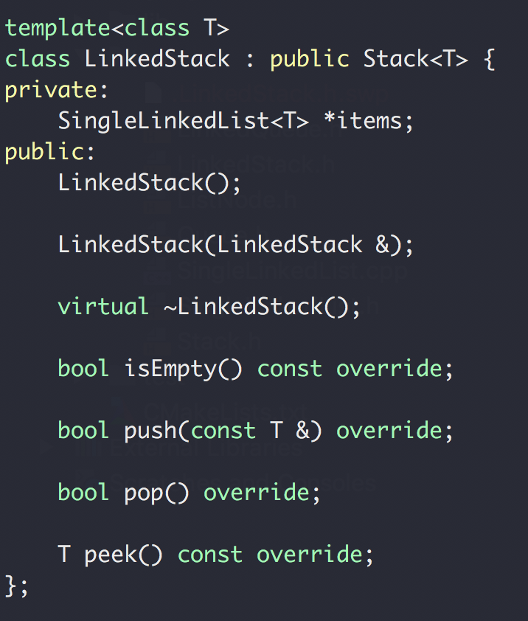
Stack
Implement the stack ADT using your own single linked list

